Slide 1
A Dog’s Life
Proposal for Website

Slide 2
Home Page
Site Map
Grooming Services
Map to Store
Contact Information
How to select a good pet

Slide 3
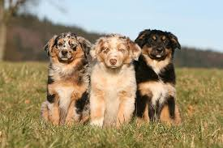




Home Page
Phone: (480) 123-4567
Address: 12345 N Chandler Blvd
Our Team
Grooming Services
Map to our Location
Contact Us
A Dog’s Life
The Valley’s favorite since 1992
A Dog’s Life
A Dog’s Life
A Dog’s Life
The Valley’s favorite since 1992
Grooming Services
Map to our Location
Contact Us
Mission Statement
A Dog’s Life is committed to providing safe, quality service
For you and your pets

Slide 4
Customer Page

Slide 5
Home Page

